Slide 1
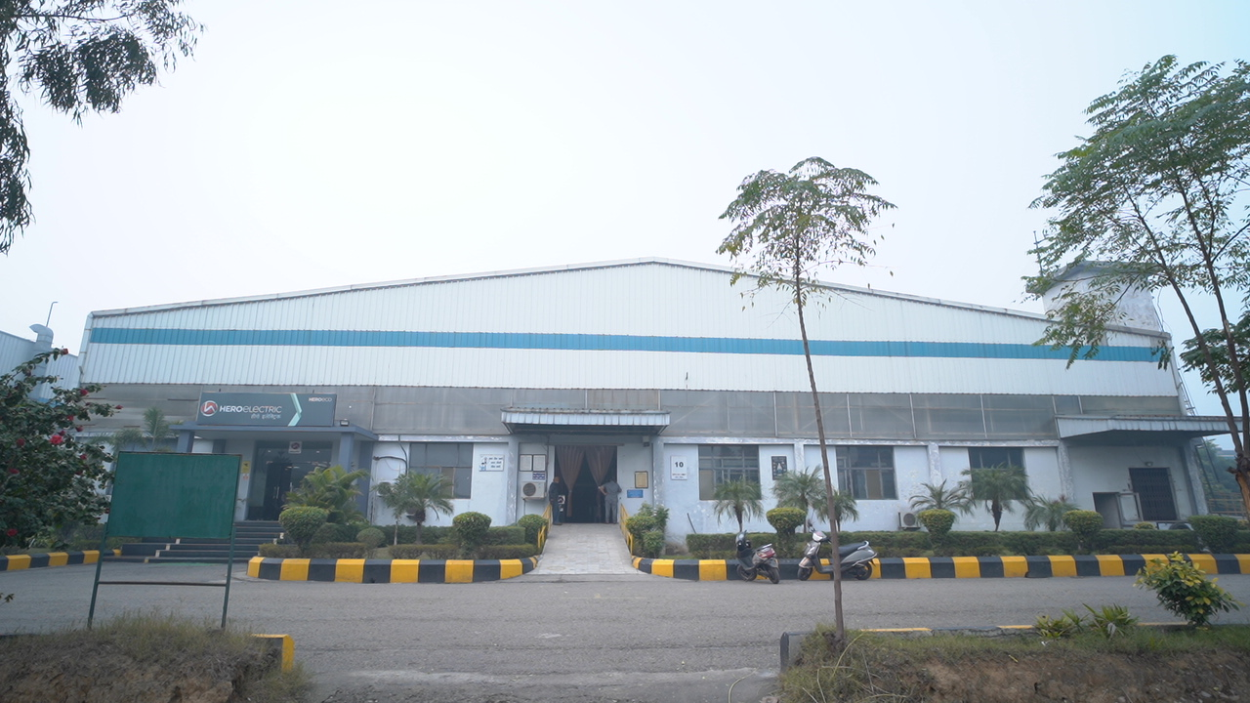
A Golden Opportunity
Private & Confidential
To own a Leading Electric Mobility Company
(Under the framework of IBC, 2016)
Company: Hero Electric Vehicles Private Limited
RP - Bhoopesh Gupta
Resolution Professional
Regn No. IBBI/IPA-001/IP-P01468/2018-2019/12271
Website: https://www.heroelectric.co.in
1

Slide 2
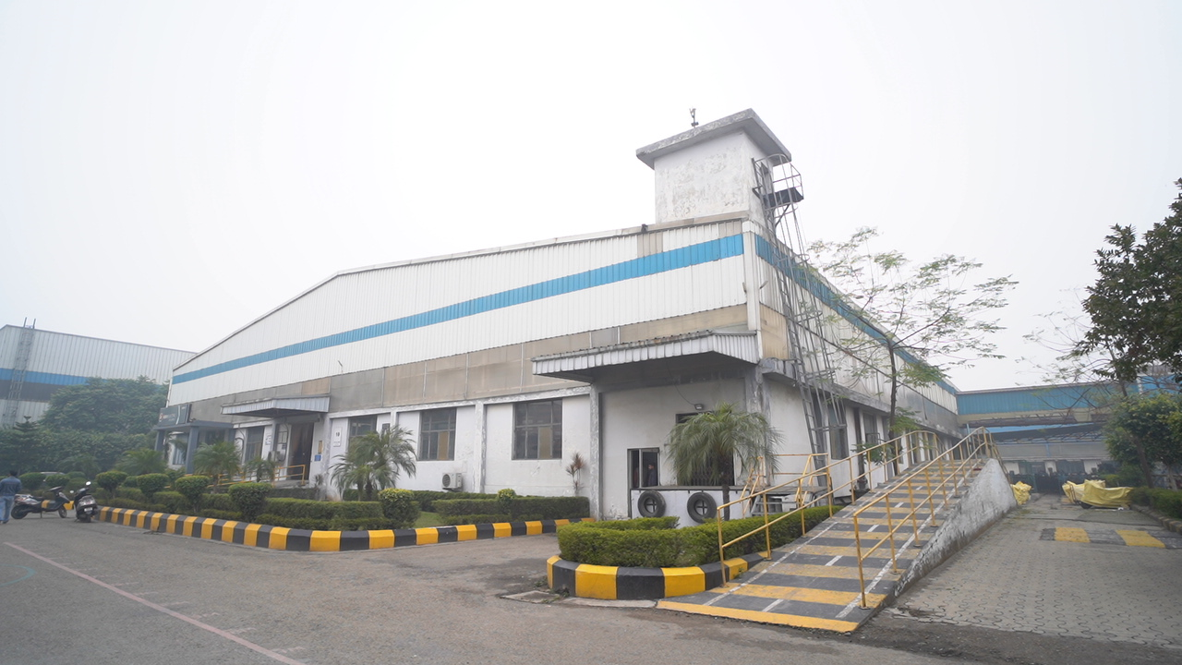
Company Profile
Company Information:
HERO ELECTRIC VEHICLES PRIVATE LIMITED
CIN : U34200DL2010PTC206520
Date of Incorporation : 31st July 2010
Registered Office : 50, Okhla Industrial Estate, Phase III,
New Delhi – 110020
Corporate Office : Plot No. 57 Udyog Vihar, Phase IV, Sector-18, Gurugram, Haryana, India, 122018
Board of Directors
Mr. Naveen Munjal
Ms. Roopa Ghosh
Note: Under IBC Process, Order for Commencement of Corporate Insolvency Resolution Process (CIRP) initiated by Hon'ble NCLT New Delhi Bench vide its order dated 20th Dec, 2024. For Order: Click Here
2

Slide 3
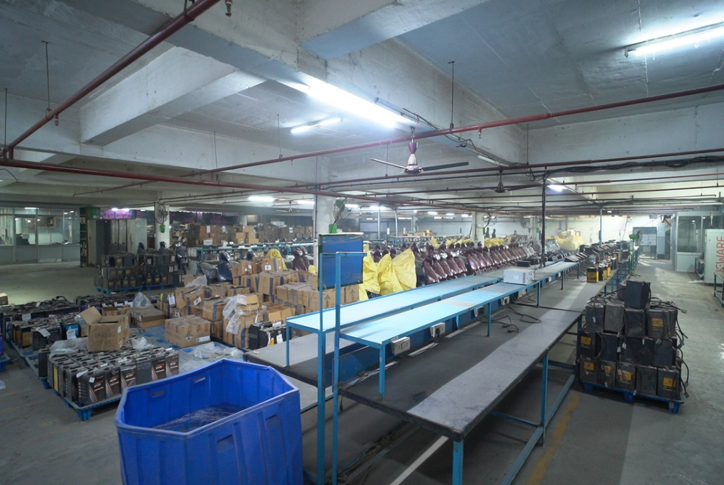
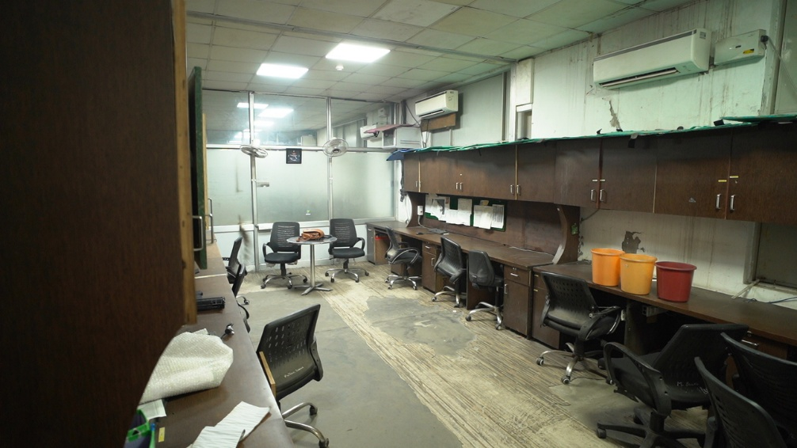
Plant location : Phase -VIII , Focal Point , Chandigarh Road , Ludhiana
Existing Business : Manufacture of Electric Scooter
Production capacity : About 70,000 to 90,000 per annum
Past Sale History : :
Project Details
Financial Year | Sales including other Income(in Crores) | Sales Volume (Units Sold) | % Increase in Units Sold | Market Share in Indian Electric Scooter Market
2020-21 | 314.07 | 15,956 | - | 36%
2021-22 | 852.39 | 68,935 | 332% | 27%
2022-23 | 993.50 | 89,874 | 30% | 12%
Interested parties can reach out at cirp.hev@gmail.com or can contact Mr Bhoopesh Gupta (RP) at 9450457403
3

Slide 4
Value Proposition
Vast Marketing Network : More than 800 dealers across the country
R & D Facility : In house facility to develop new models and product improvements
Location : In the heart of Punjab
Models Launched in 2023 | Models phased out
Hero Electric Optima CX Hero Electric Photon Hero Electric NYX HX | Optima E5 Maxi Wave DX models

Slide 5
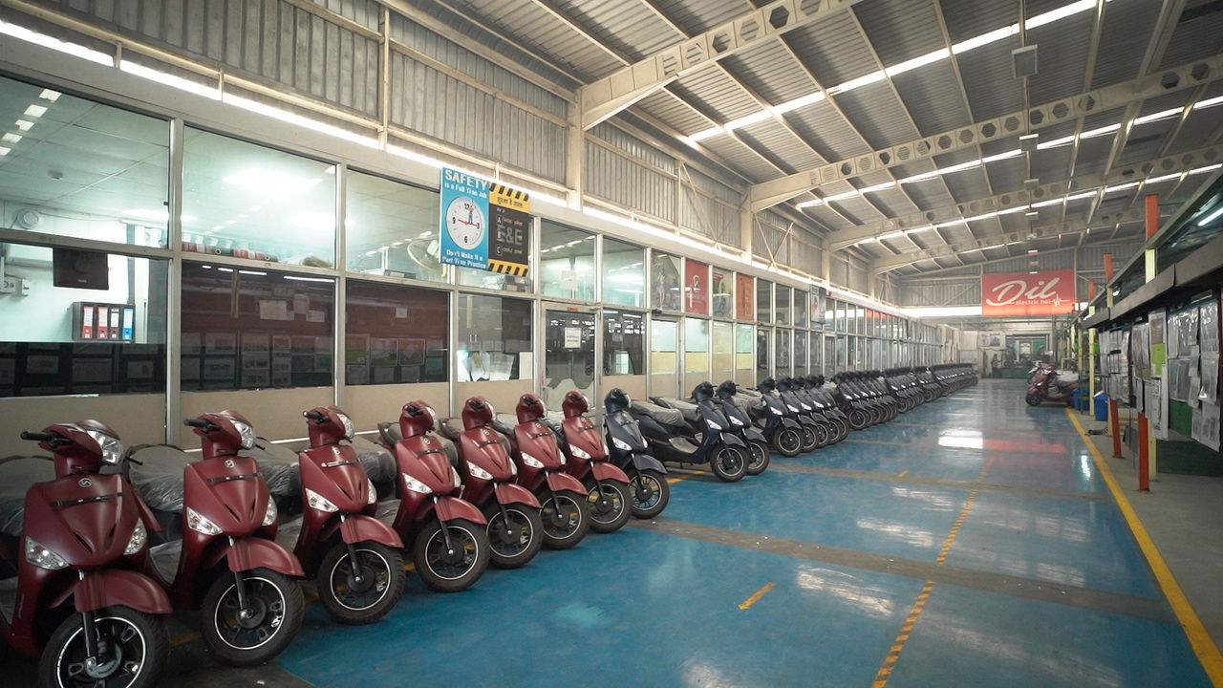
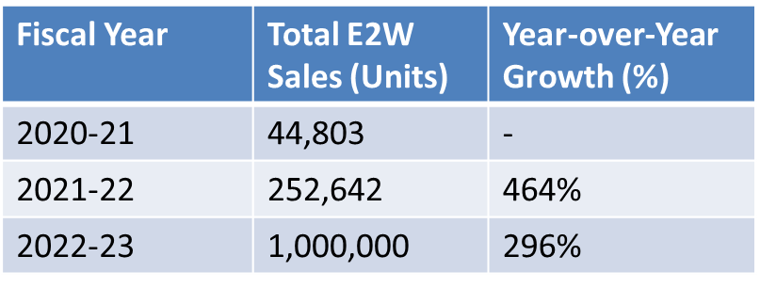
Market outlook of Electric Scooter
    Past Industry Sales Trend
Projected Industry Size
(In Value )
Year | Market Value (USD Million) | CAGR (%)
2023 | 950.40 | -
2032 (Projected) | 13,089.0 | 33.25%

Slide 6
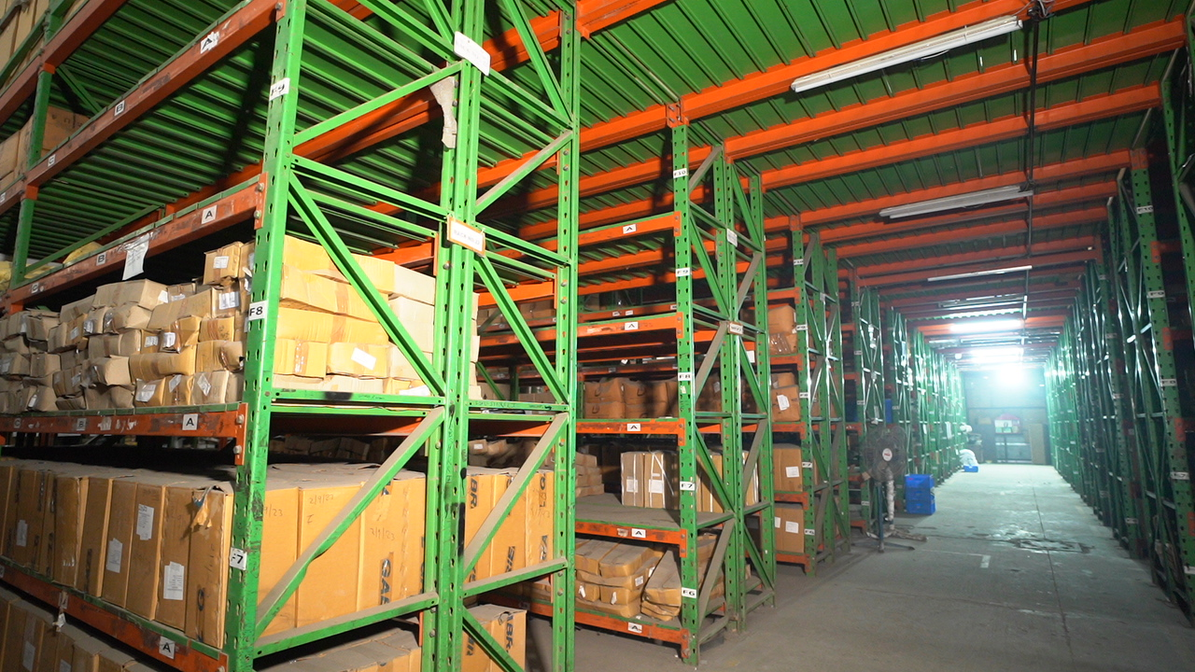
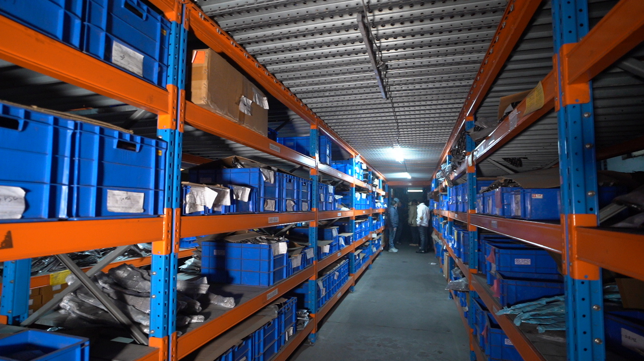
Projected Industry Size
(In Volume)
Year | Volume Growth (in Lacs Units) | Penetration Rate of Electric Scooters (%)
2023 | 10 | 13%
2030 | 140 | 75%

Slide 7
Policy initiative to promote electric vehicles (EVs) in India:
Cash subsidy under FAME
Lower GST rate
In certain states lower registration cost and exemption from road tax

Slide 8
PUBLICATON OF FORM G-INVITATION FOR EXPRESSION OF INTEREST
Public advertisement was made on 18.02.2025 in Financial Express (English), Jansatta (Hindi), for inviting Expression of Interest “EOI” for resolution of the Corporate Debtor.
Last Date for Receipt of EOI: 14.03.2025
Last Date of Submitting Resolution Plan: 13.05.2025

Slide 9
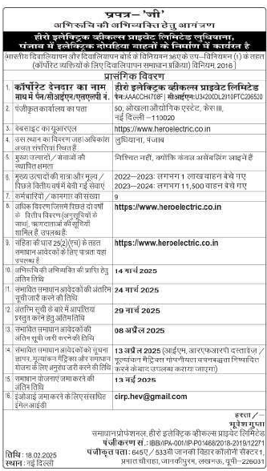
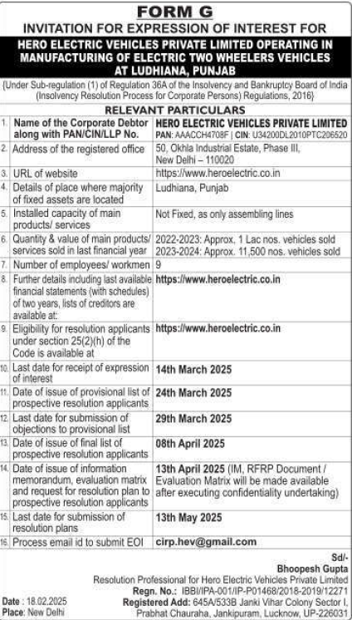
PUBLICATON OF FORM G-INVITATION FOR EXPRESSION OF INTEREST
Publication in Jansatta- (Hindi) & Financial Express-English
Date of Publication 18.02.2025
Form G: Click Here

Slide 10
Disclaimer
The information contained/disclosed in the Flyer is as provided by the Corporate Debtor and the creditors of the Corporate Debtor. No representation or warranty, express or implied, is given by the Corporate Debtor, any of its Officers, Employees or its Agents or the Resolution Professional or his team as to the accuracy, authenticity or completeness of the contents of this Flyer or any other document or information supplied, or which may be supplied at any time or any opinions or projections expressed herein or therein, nor is any such party under any obligation to update the Flyer or correct any inaccuracies or omissions in it which may exist or become apparent.
For clarification, if any, please contact Mr Bhoopesh Gupta (Resolution Professional) at 9450457403 or the undersigned at the address given below.
AVM Resolution Professionals LLP
Phone: 011-41486026/27
Email ID: cirp.hev@gmail.com
Add: 3rd floor, 8/28, WEA, Abdul Aziz Road, Karol Bagh, New Delhi, 110005

Slide 11
Thank You

